Slide 1
Discrete Mathematics
Xiaowei Yang
South China University of Technology

Slide 2
Chapter 5. Relations
Closures of Relations
Section 5.4

Slide 3
Contents
1
Closures
2
Transitive Closures
3
Warshall’s Algorithm

Slide 4
Closures

Slide 5
§5.4: Closures of Relations
For any property X, the “X closure” of a set A is defined as the “smallest” superset of A that has property X. More specifically,
The reflexive closure of a relation R on A is the smallest superset of R that is reflexive.
The symmetric closure of R is the smallest superset of R that is symmetric
The transitive closure of R is the smallest superset of R that is transitive

Slide 6
Calculating closures
The reflexive closure of a relation R on A is obtained by “adding” (a,a) to R for each a∈A. I.e., it is R ∪ I_{A} (Check that this is the r.c.)
The symmetric closure of R is obtained by “adding” (b,a) to R for each (a,b) in R.
I.e., it is R ∪ R⁻¹ (Check that this is the s.c.)
The transitive closure of R
is obtained by “repeatedly” adding (a,c) to R
for each (a,b),(b,c) in R …

Slide 7
Calculating closures
Adore={(a,b),(b,c),(c,c)}
Detest={(b,d),(c,a),(c,b)}
The symmetric closure of ...
  ... Adore={(a,b),(b,c),(c,c),(b,a), (c,b)}
  ... Detest={(b,d),(c,a),(c,b), (d,b), (a,c),(b,c)}

Slide 8
Calculating closures
Adore={(a,b),(b,c),(c,c)}
Detest={(b,d),(c,a),(c,b)}
The transitive closure of ...
  ... Adore={(a,b),(b,c),(c,c),(a,c)}
  ... Detest={(b,d),(c,a),(c,b),(c,d)}

Slide 9
Example 1
What is the reflexive closure of the relation R = { (a,b) | a < b } on the set of integers?
Solution:
The reflexive closure of R is
R U ∆ = { (a,b) | a<b } U { (a,a) | a ∈ Z }
= {(a,b) | a≤b }

Slide 10
Example 2
What is the symmetric closure of the relation R = { (a,b) | a>b } on the set of positive integers?
Solution:
The symmetric of closure of R is the relation
R U R^-1 = { (a,b) | a>b } U { (b,a) | b>a}
= { (a,b) | a≠b }

Slide 11
Transitive Closures

Slide 12
Definition 2
Let R be a relation on a set A.
The connectivity relation R* consists of the pairs (a,b) such that there is a path of length at the least one from a to b in R.

Slide 13
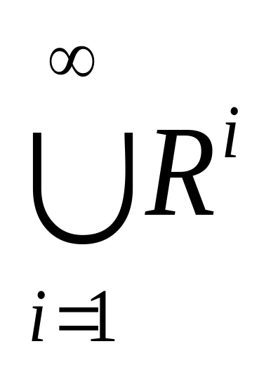
R*
How would you formally define R*?
Here’s a safe bet

Slide 14

R*
How would you formally define R*?
Here’s a finite variant, where n = |A|
(proof in book that n is large enough)

Slide 15
Example 4
Let R be the relation on the set of all people in the world that contains (a,b) if a has met b, What is R^n, where n is a positive integer greater than one?
R^n consists of those pair (a,b) such that there are people x1,x2,…,xn-1 such that a has met x1, x1 has met x2,…, and xn-1 has met b.

Slide 16
Example 5
Let R be the relation on the set of all people in the world that contains (a,b) if a has met b, What is R*, where n is a positive integer greater than one?
The relation R* contains (a,b) if there is a sequence of people, starting with a and ending with b, such that each person in the sequence has met the next person in the sequence.

Slide 17
Proof of Theorem 2
Theorem: R* = the transitive closure of R
We need to prove that R* is the smallest transitive superset of R.
1. Proof that R* is transitive:
Suppose xR*y and yR*z.
E.g., xR^{n}y and yR^{m}z
Then xR^{n+m}z, hence xR*z

Slide 18
Proof of Theorem 2
Theorem: R* = the transitive closure of R
2. We now know that R* is transitive.
Evidently, R⊆R*. Prove that there cannot be
a smaller transitive superset S of R than R*:
Suppose such a transitive superset of R existed.
This would mean that there exists a pair (x,y) such that xR*y while ¬xSy.
But xR*y means ∃n such that xR^{n}y. But since R⊆S, it would follow that xS^{n}y; but because S is transitive, this would imply that xSy. Contradiction.
Tips : The relation R on a set A is transitive if and only if R^n ⊆ R for n = 1,2,3…

Slide 19
Lemma 1
Lemma: Let A be a set with n elements, and let R be a relation on A.
If there is a path of length at least one in R from a to b, then there is such a path with length not exceeding n.
Moreover, when a ≠ b, if there is a path of length at least one in R from a to b, then there is such a path with length not exceeding n-1.

Slide 20
Proof of Lemma 1
Proof:
Supposed there is a path from a to b in R. Let m be the length of the shortest such path.
Supposed that x0,x1,x2,…,xm-1,xm, where x0=a and xm=b, is such a path.
Supposed that a = b and that m > n, so that m≥n+1. By the pigeonhole principle, since there are n vertices in A, among the m vertices x0,x1,…,xm-1, at least two are equal.

Slide 21
Supposed that xi=xj with 0≤i ≤j ≤m-1. Then the path contains a circuit from xi to itself.
The circuit can be deleted from the path from a to b, leaving a path, namely, x0, x1,…,xm-1,xm, from a to b of shorter length.
Hence, the path of shortest length must have length less than or equal to n.

Slide 22
From Lemma 1, we have:
R* = R^1 U R^2 U R^3 U … U R^n
The transitive closure of R is also equal to
R^1 U R^2 U R^3 U … U R^n.

Slide 23
Theorem 3
Let M(R) be the zero-one matrix of the relation R on a set with n elements. Then the zero-one matrix of the transitive closure R* is
M(R*)
=M(R) V M(R)^2 V M(R)^3 V … V M(R)^n
The proof is similar to Lemma 1.

Slide 24
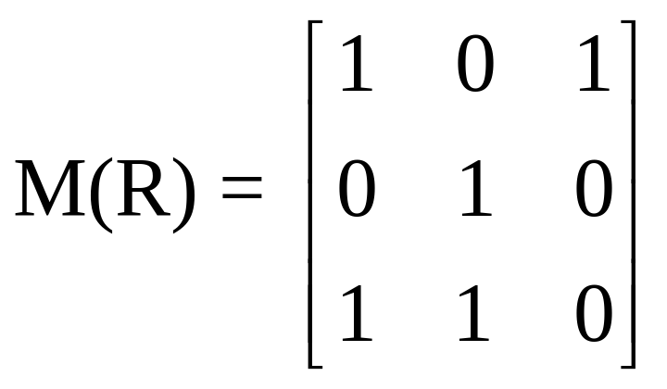
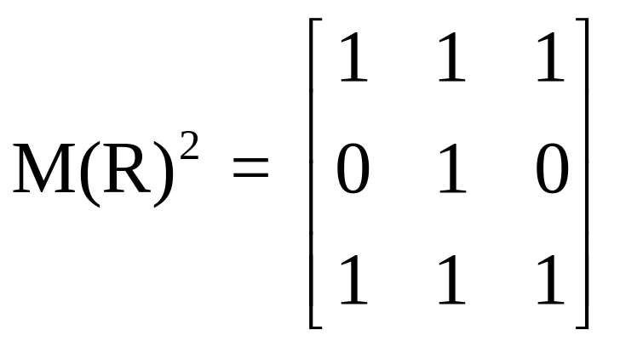
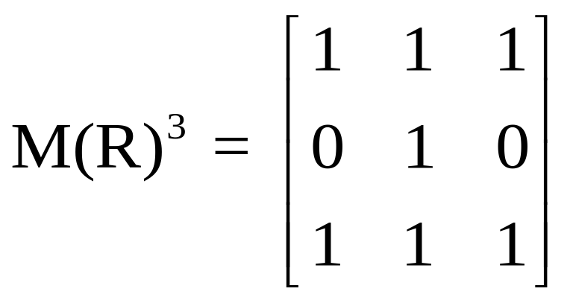
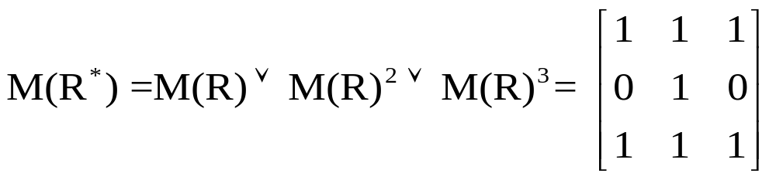
Example 6

Slide 25
Algorithm of Computing TC
Procedure transitive closure (M(R): zero-one nxn matrices)
A:= M(R)
B:=A
for i:=2 to n
begin
A:=A o M(R)
B:=B V A
end {B is the zero-one matrix for R*}
2*(n-1)*n^3
bit operations

Slide 26
Warshall’s Algorithm

Slide 27
Fast algorithms are available for calculating R*, especially Warshall’s algorithm
(also called Roy-Warshall algorithm)
FYI: this algorithm uses a matrix representation.

Slide 28
Idea of Warshall’s Algorithm
The algorithm is based on the construction of a sequence of zero-one matrices.
The matrices are W(0),W(1),…,W(n), where W(0) = M(R) is the zero-one matrix of this relation, and W(k) = [ wij(k) ].
wij(k) = 1 if there is a path from vi to vj such that all the interior vertices of this path are in the set { v1,v2,…,vk } and is 0 otherwise.

Slide 29
Idea of Warshall’s Algorithm
W(n) = M(R*)
Because the (i,j)th entry of M(R*) is 1 if and only if there is a path from vi to vj, with all interior vertices in the set
{v1, v2, …, vn}.

Slide 30
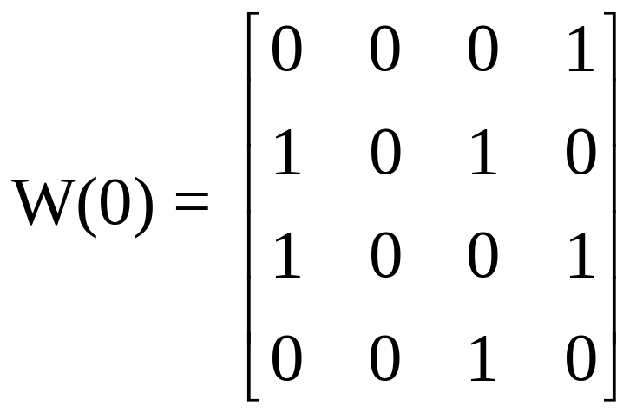
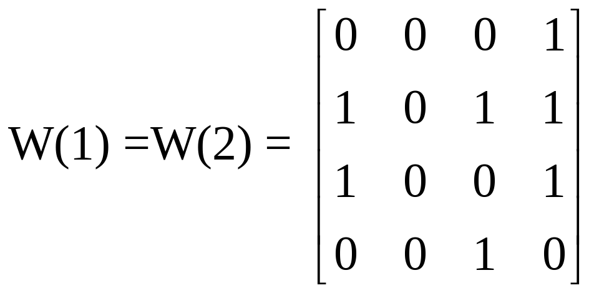
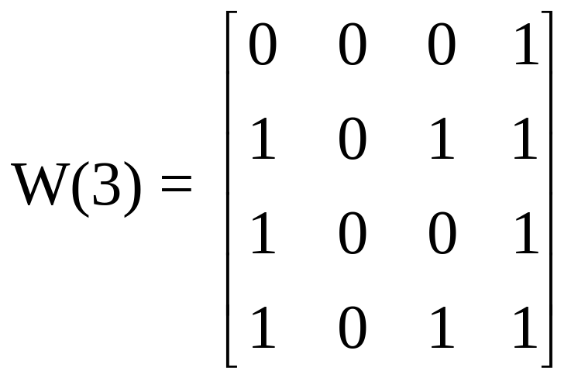
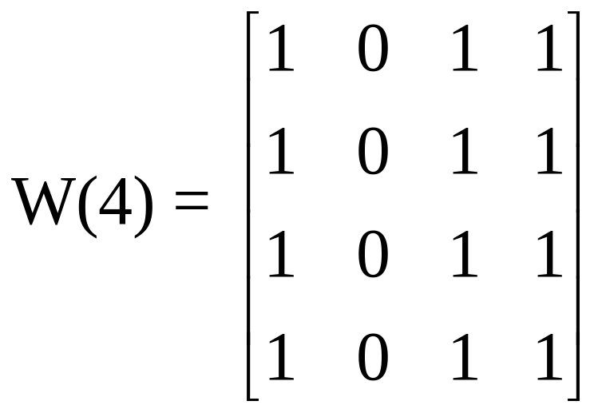
Example 8

Slide 31
How to compute W(k)
Lemma 2 give us the means to compute efficiently the matrices W(k), k=1,2,…,n.
wij(k) = wij(k-1) V (wik(k-1) Λ wkj(k-1) )

Slide 32
Warshall Algorithm
Produre Warshall (M(R): n x n 0-1 Matrix)
W := M(R)
for k:=1 to n
begin
for i:=1 to n
begin
for j:=1 to n
wij(k) = wij(k-1) V (wik(k-1) Λ wkj(k-1) )
end
end {W = [wij] is M(R*)}
2*n^3
bit operations

Slide 33
Applications

Slide 34
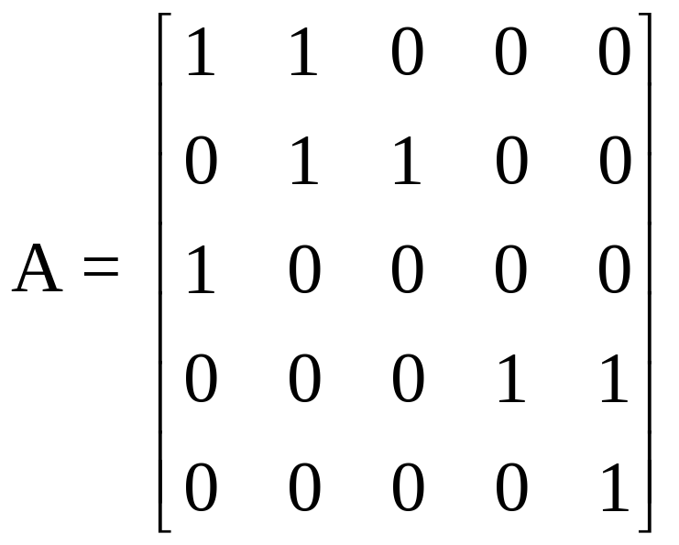
Applications
1.Consider the relation R on A={1,2,3,4,5} given by the adjacency matrix， run Warshall’s algorithm to find the adjacency matrix of the transitive closure of R.

Slide 35
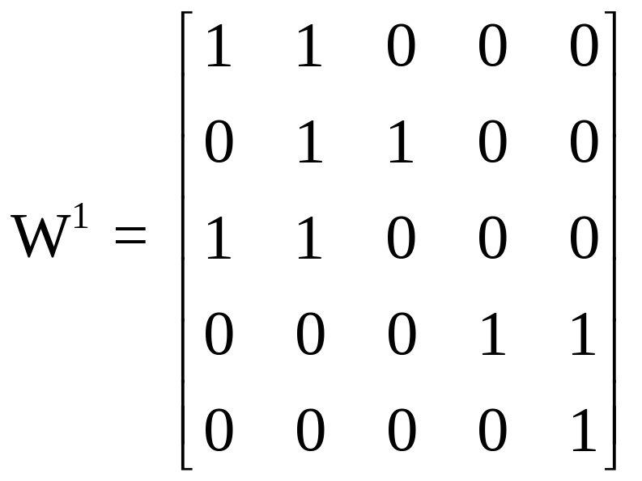
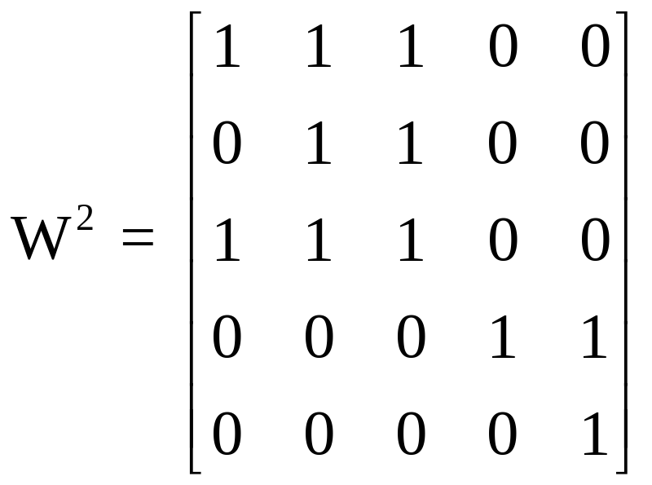
Applications
Solution. Consider the relation R on A={1,2,3,4,5} given by the adjacency matrix， run Warshall’s algorithm to find the adjacency matrix of the transitive closure of R.

Slide 36
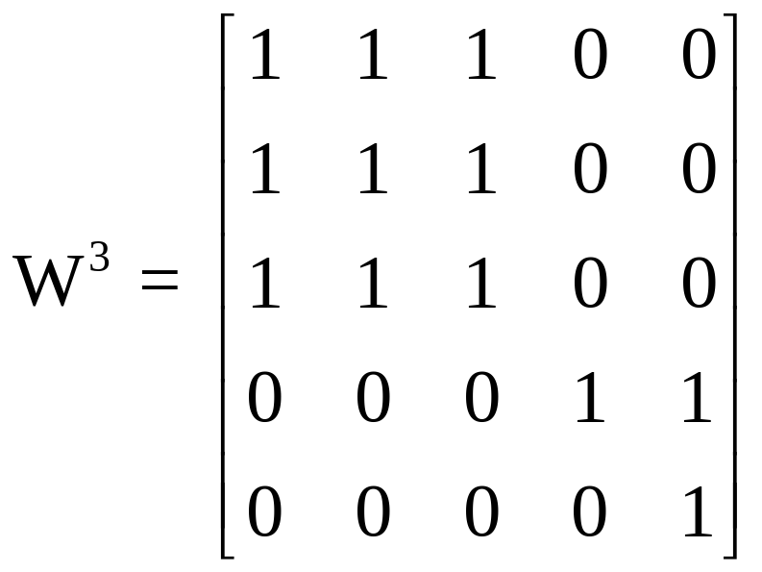
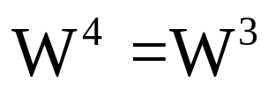
Applications
Solution. Consider the relation R on A={1,2,3,4,5} given by the adjacency matrix， run Warshall’s algorithm to find the adjacency matrix of the transitive closure of R.

Slide 37



Applications
Solution. Consider the relation R on A={1,2,3,4,5} given by the adjacency matrix， run Warshall’s algorithm to find the adjacency matrix of the transitive closure of R.
2

3
1


5
4



Slide 38
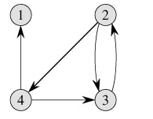
Applications
2.Consider the relation R on T={1,2,3,4} shown below. Run Warshall’s algorithm to find the adjacency matrix of the transitive closure of R.





Slide 39
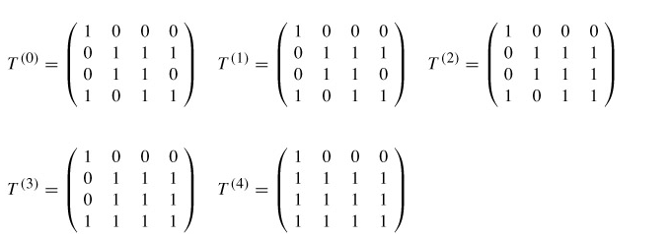
Applications
Solution.Consider the relation R on T={1,2,3,4} shown below. Run Warshall’s algorithm to find the adjacency matrix of the transitive closure of R.

Slide 40
End of Section 5.4
Click to edit company slogan .

